Slide 1


Recording, Analyzing and Using Physiological Signals in Psychology
Dominique Makowski
D.Makowski@sussex.ac.uk
04/2024 Workshop at

Slide 2
Signal Processing

Slide 3
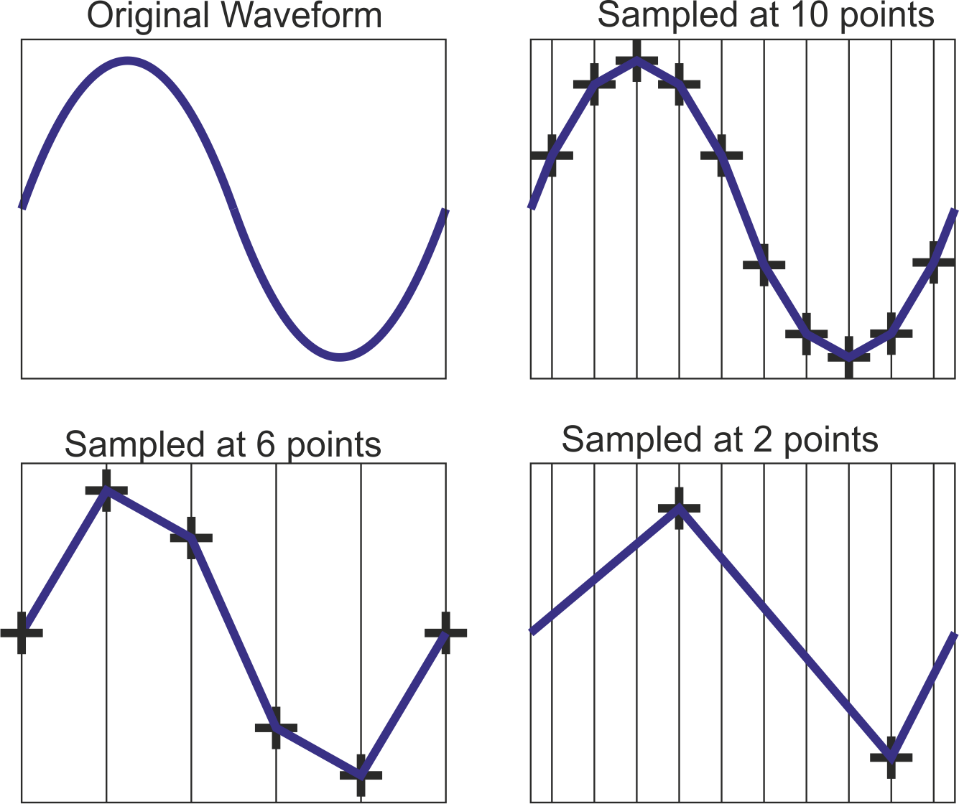
Sampling Rate
Analog to digital transformation involves a loss of information
Sampling rate (SR): the number of samples of a signal taken per second, measured in Hertz (Hz) [samples per second]
Sampling rate corresponds to the “temporal resolution” of the recorded signal
Sampling rate is the main “spec” that varies between equipment
Empatica bracelet for EDA: 4 Hz; Muse 2 EEG: 256 Hz; Bitalino: 1000 Hz; Brain Products EEG: 4000 Hz
“Good” sampling rate depends on the signal of interest. Some signals carry important information in high frequency bands (EEG, ECG), some signals have slow dynamics (EDA, Respiration)

Slide 4
Nyquist frequency
Problem of aliasing: the distortion that occurs when a signal is undersampled
Undersampling might lead to capturing “phantom” signal that doesn’t reflect the underlying signal
Nyquist Sampling Theorem
The sampling rate should be at least double of the maximum frequency you want to accurately capture
The Nyquist frequency is half of the sampling rate
If your SR = 500 Hz, you can only accurately represent frequencies < 250 Hz
Good to oversample when possible
Anti-aliasing filters to remove the “possibly distorted” frequencies of a signal
If SR = 500 Hz, apply a filter to remove frequencies between 250 and 500 Hz

Slide 5
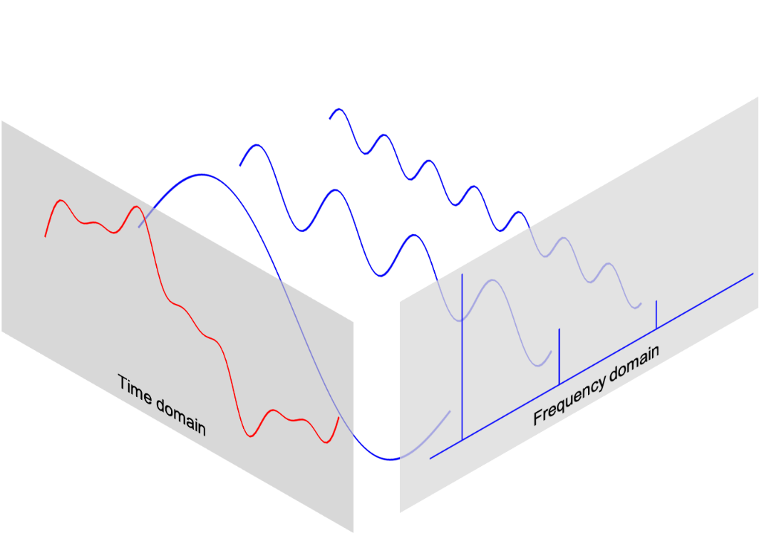
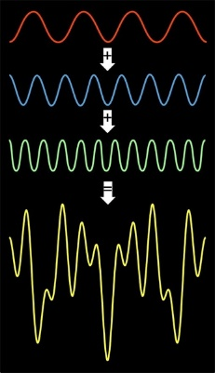
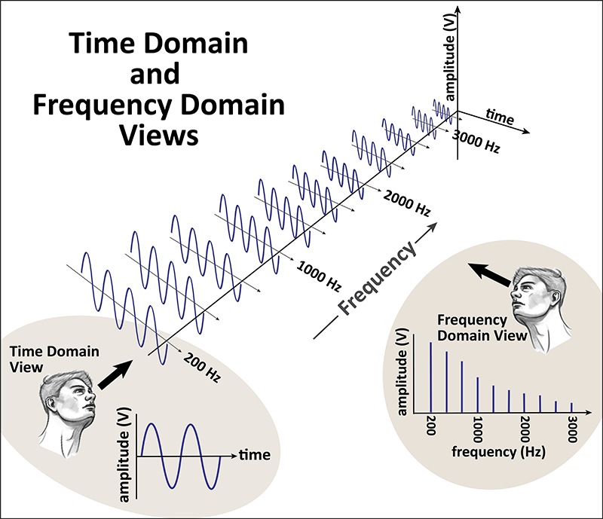
Fourier transform
Most “real life” signals are not pure frequencies, but contain various different frequencies
The signal observed can be seen as a combination of pure signals (sine waves) of different frequencies
Some of these frequencies are more “prominent” (i.e., powerful) than others
The Fourier Transform (FT) allows to go from the time-domain (amplitude / time) to the frequency-domain (power / frequency) of a signal
Obtain the “power spectrum”, i.e., the power distribution over the frequency spectrum
The inverse can be done using the inverse FT
Most common algorithm is Fast Fourier Transform (FFT)

Slide 6
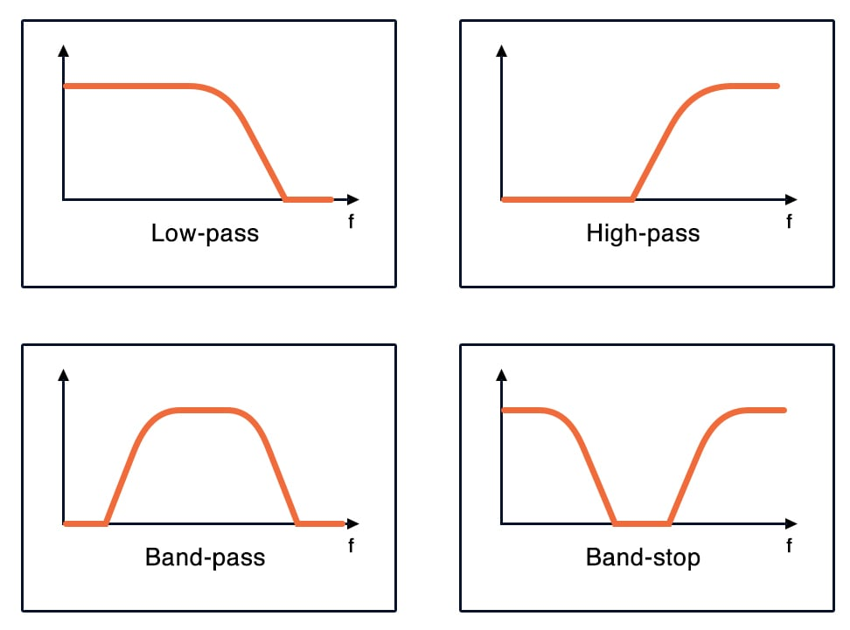
Filtering
Filters are used to “suppress” unwanted frequencies
Different types of filters: Low-pass/high-pass; band-stop (e.g., Notch filter)
Different algorithms: Each with limitations
We often want to:
Low-pass below the Nyquist frequency (1/2*SR)
Remove electrical noise (Notch filter at 50 Hz)
High pass to remove slow drifts
…
Balance between removing noise and distorting signal
Sometimes “signal is best kept raw”
Filtering needs depends on the quality of the recording

Slide 7
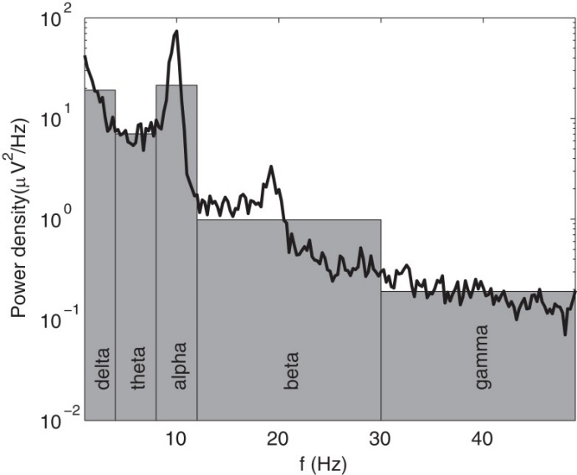
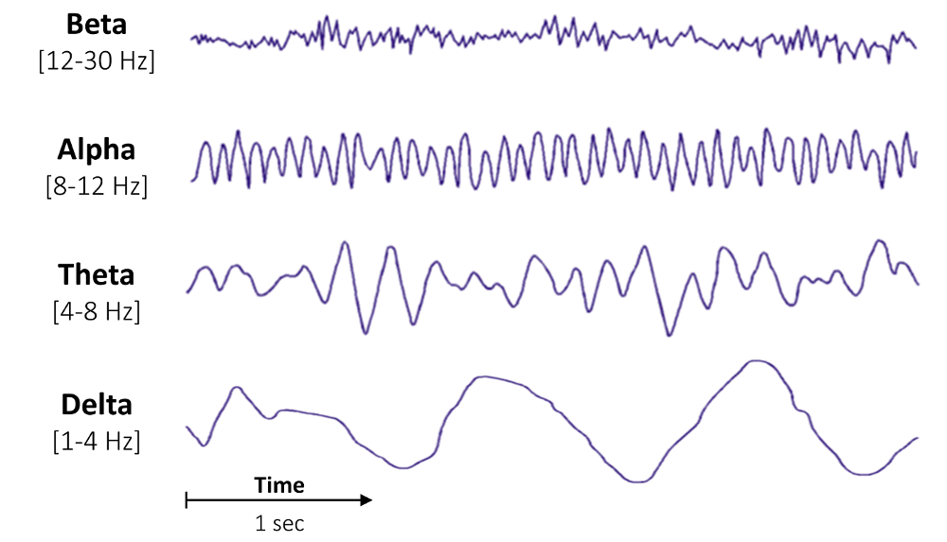
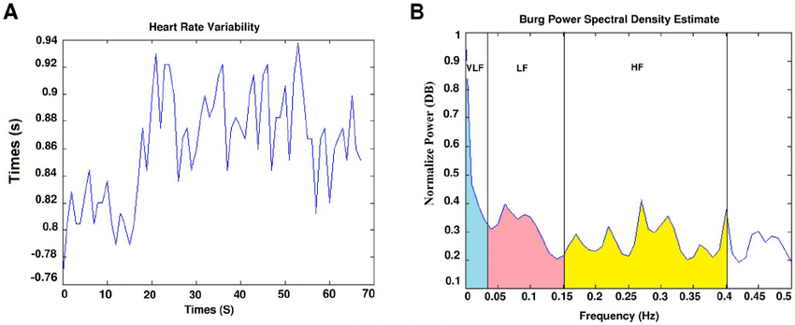
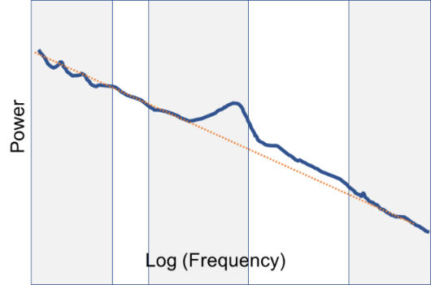
Frequency Analysis
Frequency analysis takes interest in the power spectrum of the signal (frequency-domain view)
The goal is to describe the shape of the power spectrum: which frequencies are the strongest
Various approaches
Categorize the frequency spectrum into discrete “bands” and compute the power (area under the curve)
Measure the “slope” of the power spectrum

Slide 8
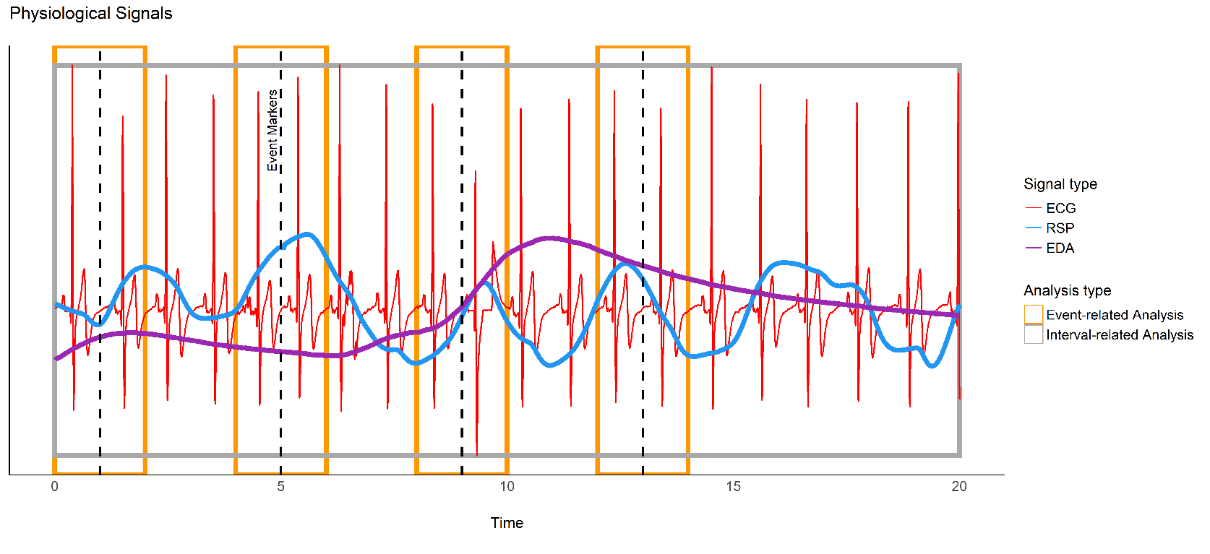
Epochs
Event-related analysis often involves the creation of epochs
Short windows of signal relative to each event
We can then compute features of interest in each epoch (i.e., for each event)
E.g., mean heart rate, max of EDA, …
The size of the epochs depends on the features that we want to extract
Much shorter epochs (e.g., [-0.5s, 1s]) for EEG than for EDA (e.g., [0, 8 s])

Slide 9
Time-Delay Embedding
TODO: Run attractors of heart rate, RSP, RSP rate, EEG in resting state for all subjects (from interoprimals paradigm).
Plot the overlays

Slide 10
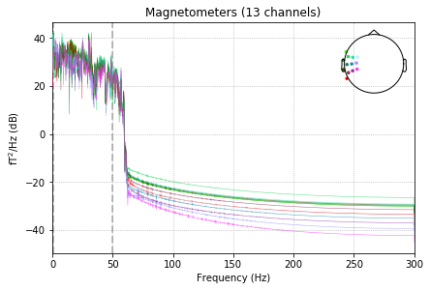
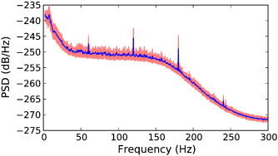
Quizz
A sampling rate of 100 Hz is enough to capture activity occuring within the 70-80Hz range
The Fourier transform allows to go from the frequency-domain to the time-domain
What filter has been applied in Fig 1
What does Fig 2 show
What solutions?

Slide 11
Setting-up Python

Slide 12
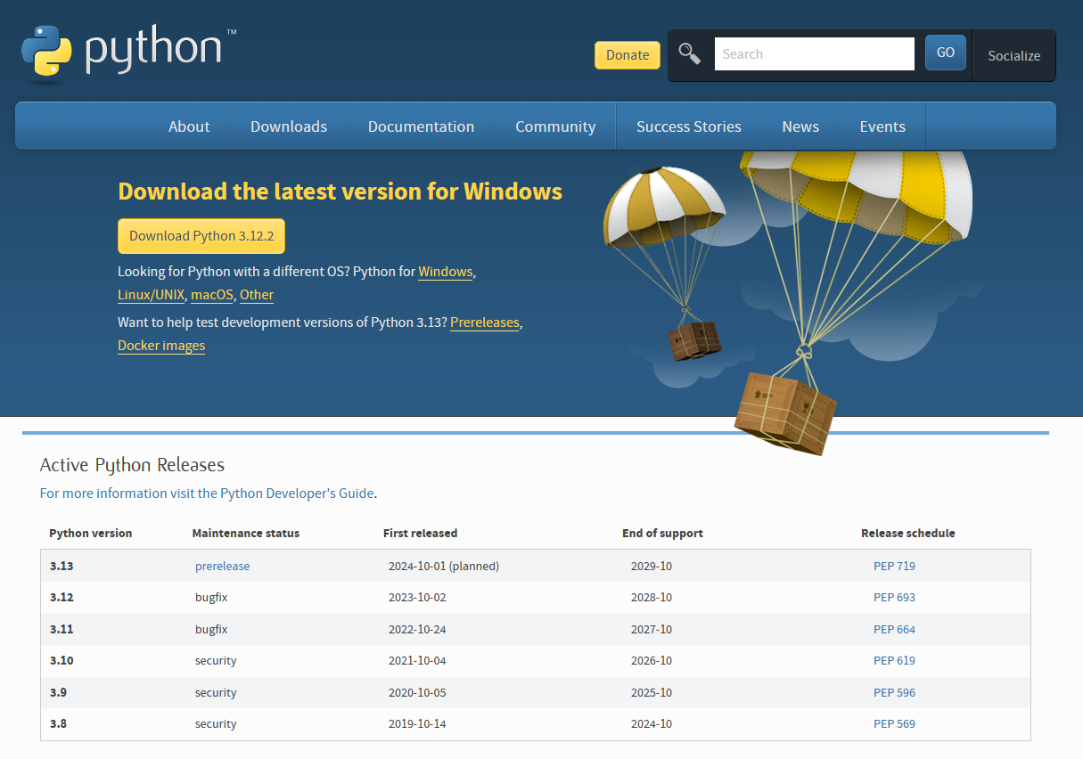
Python
Download
python.org/downloads
Download latest version of Python 3 (= 3.x)
Install it
On Windows: tick the “add Python to the path” box at the end of the installation

Slide 13
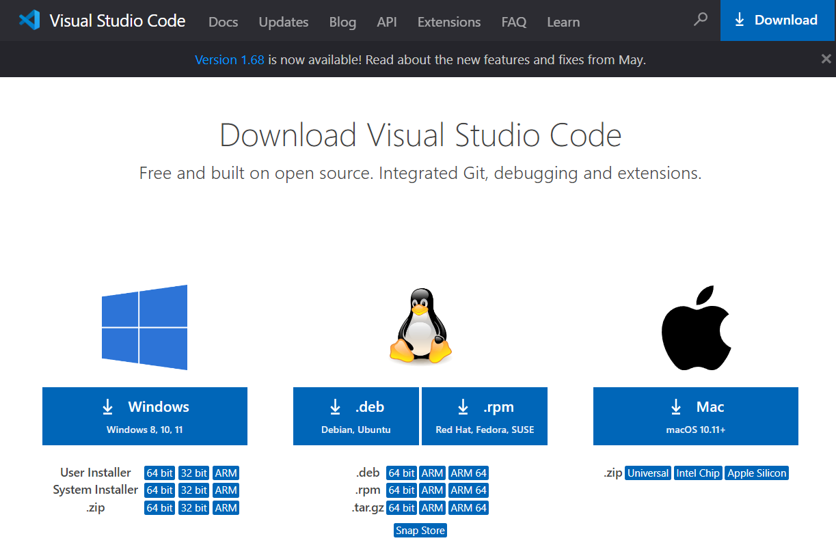
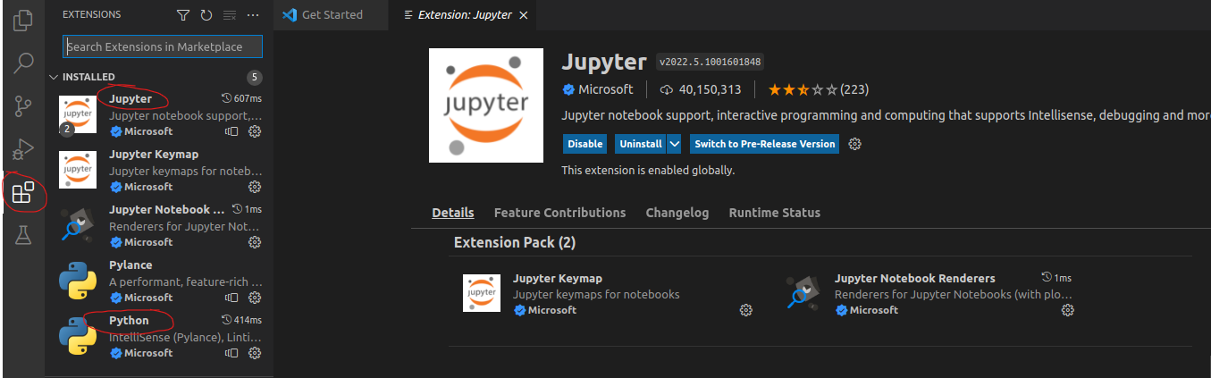
VS Code
VS Code
Still somewhat clunky, but becoming the default environment
Installation
Download VS Code
code.visualstudio.com/download
Install it
Extensions
Go to “Extensions”
Install Python & Jupyter

Slide 14
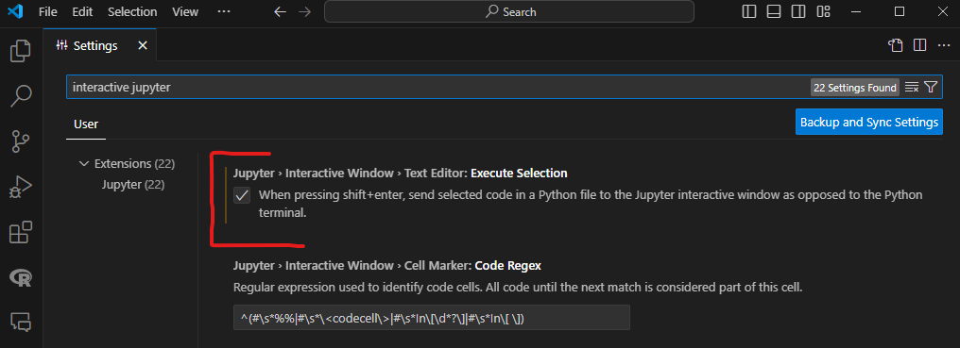
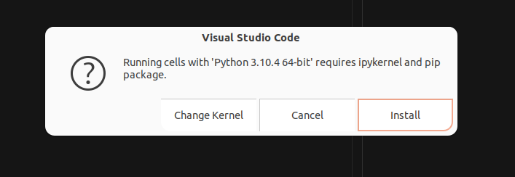
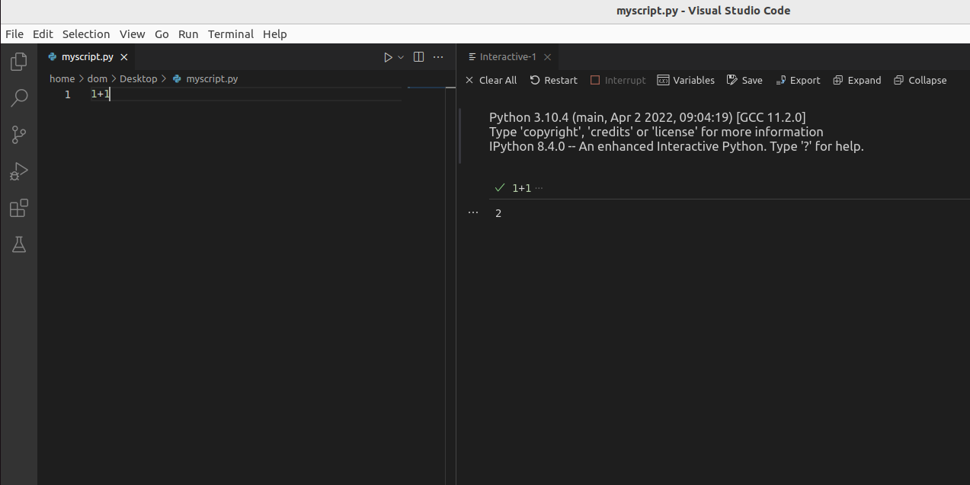
Interactive Mode
Enabling “Interactive Mode”
Click on the "View" tab (top)
then Command Palette, then type "Settings" and select Open Settings (UI)
In the settings, search "interactive jupyter" and tick Execute Selection ("when pressing shift+enter, send selected code...)
Start Interactive Window
Create New File and save it (Ctrl+S) the file into whichever directory in your computer you want, naming the file with a .py extension (so that VSCode knows that it's a Python file)
Type 1+1 in the script, select the code and press Shift+Enter. It should open the interactive window
If prompted, install ipykernel / pip

Slide 15
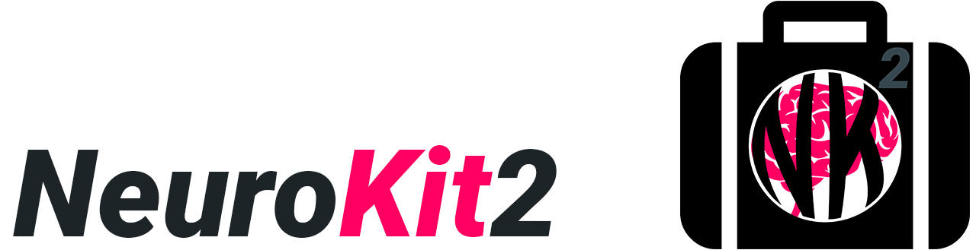
Physio processing

Slide 16
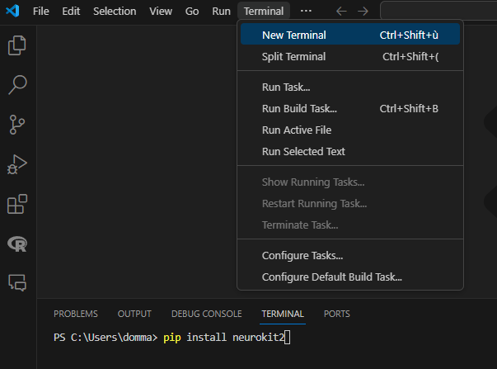
Installation
Open ”Terminal”
In VS Code: ”Terminal” tab -> New Terminal
Install Python package
pip install neurokit2 (windows)
python3 pip install neurokit2
Load package
After installing the package one can load it in a Python script by running:
”import neurokit2 as nk”

Slide 17
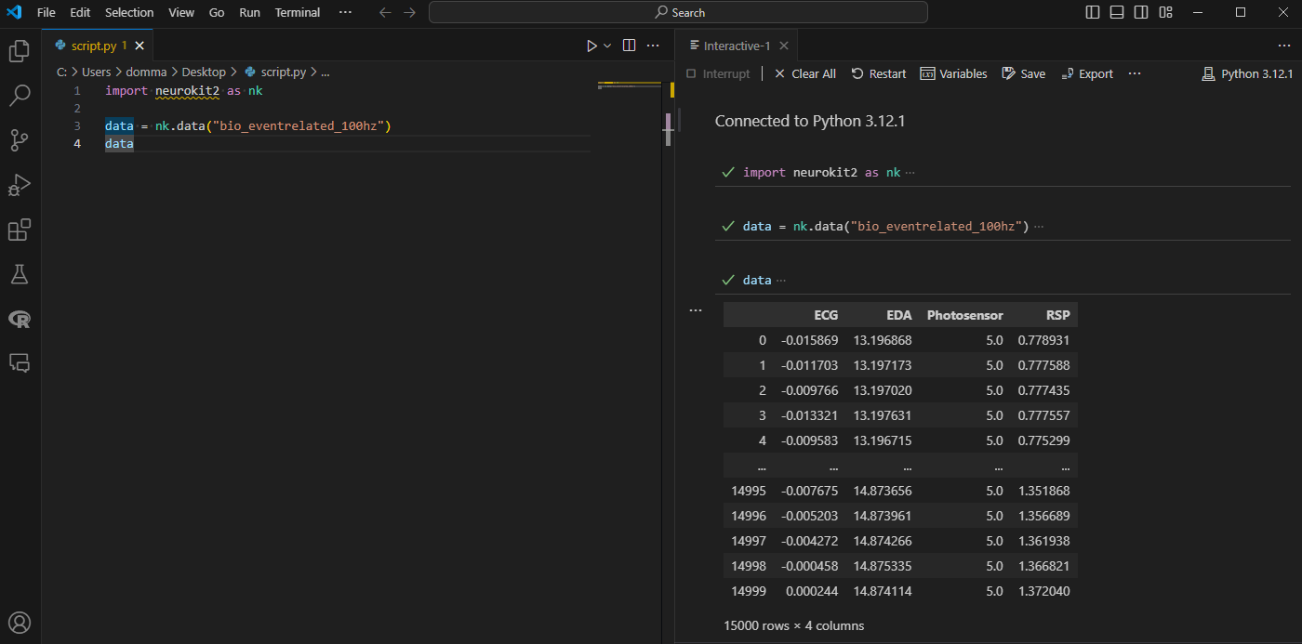
NeuroKit2
Download example data
data = nk.data("bio_eventrelated_100hz")
data
NeuroKit works with “vectors” (time series) of signals
Important to know the sampling rate
Multiple signals can be stored in a DataFrame (each signal is a column)

Slide 18
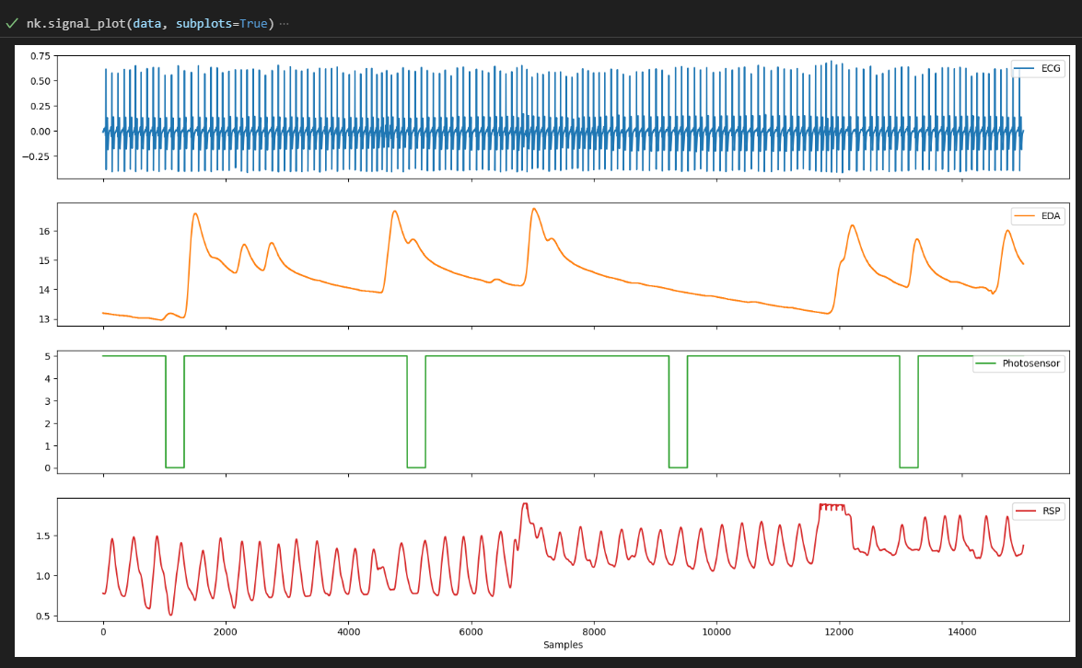
Visualization
nk.signal_plot(data, subplots=True)
Notice the “photosensor” signal

Slide 19
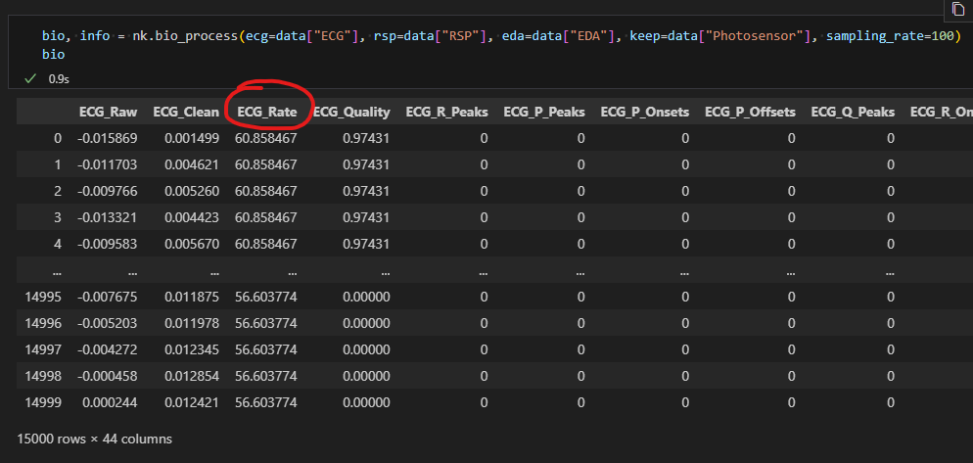
Cleaning
The signal here is rather clean, but we can still run a preprocessing routine
nk.bio_process()
Pass different signals to different arguments
This function returns a dataframe with newly computed “signals”
E.g., Heart Rate, …
Notice the “double” return

Slide 20
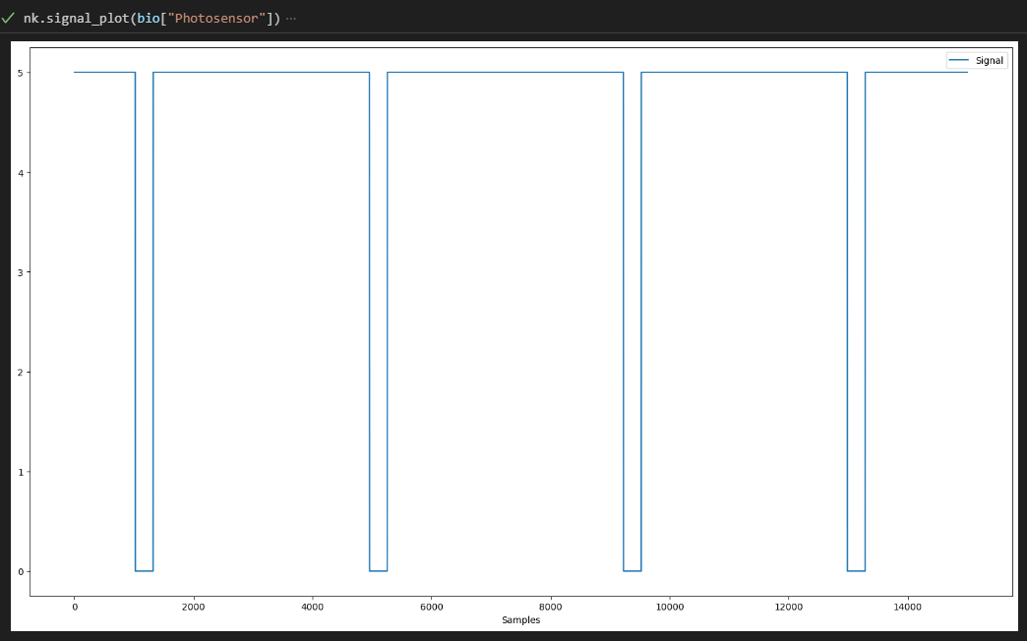
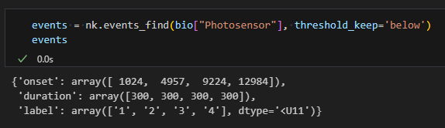
Find events
Photosensor signal went down for every trial
nk.events_find(bio["Photosensor"])
We want to get the times when the signal crossed a threshold downwards (went “below”)
Returns a dictionary with the “onset” of each event

Slide 21
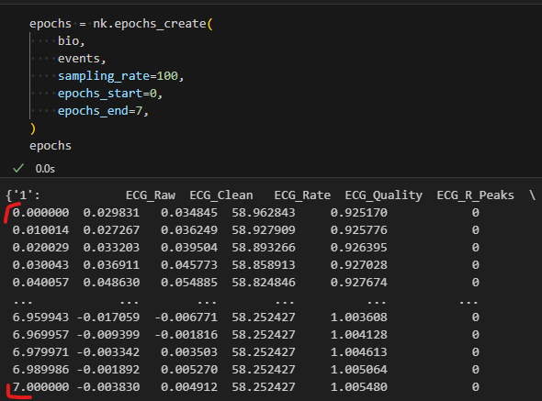
Epoching
nk.epochs_create()
Cuts the dataframe into multiple ones (one for each event)
Each dataframe has an index expressed in “seconds”

Slide 22
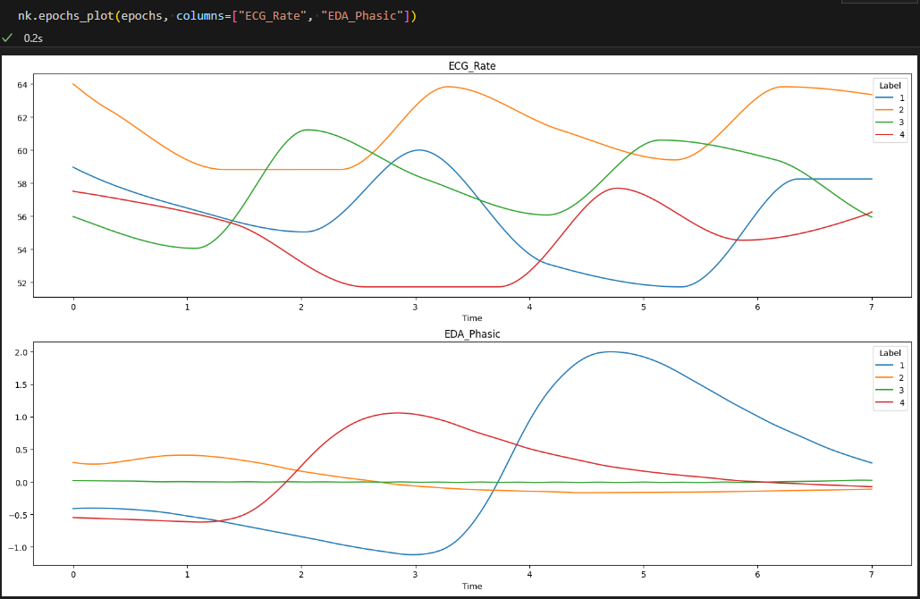
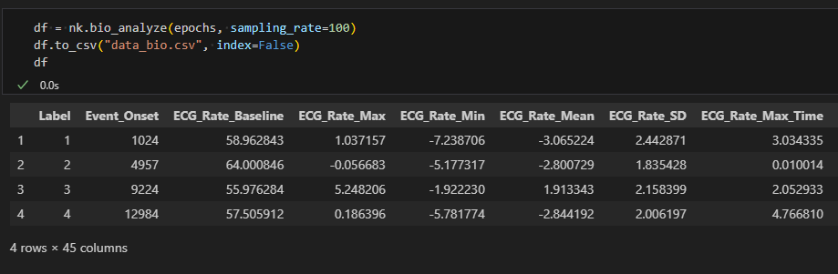
Feature extraction
nk.bio_analyze()
Will extract “default” features, such as the average heart rate (in the window)
One row per event
Save it, combine with behavioural data, and analyze!

Slide 23
Let’s do it!

Slide 24
Affective Neuroscience: Emotions and Emotion Regulation

Slide 25
Cf. NPPS

Slide 26

Thank you
Dominique Makowski
D.Makowski@sussex.ac.uk

